Slide 1
Spieleentwicklung
Spiele 3D

Slide 2

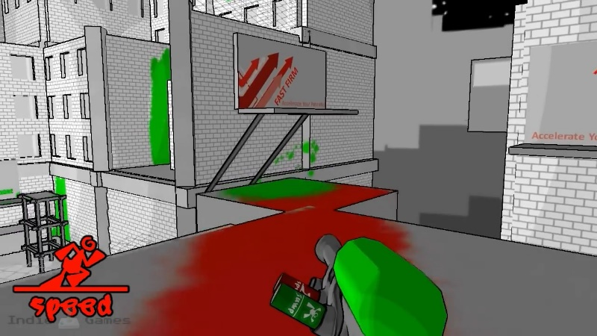
Goal of the lecture
Implement a number of game prototypes
Understand underlying concepts
3d computer graphics (Rendering Pipeline, Cameras, …)
Game mathematics, physics, mechanics
Working with a game engine (Unity 3D)

Slide 3
LVA structure
 | Month 1 |  |  |  | Month 2 |  |  |  | Month 3 |  |  |  | Month 4
1st Part | L | L | L | L | L | L | L | L | L | L | L | L | L | L | L | L
2nd Part | T | C | P | C | T | C | P | C | T | C | P | C | T | C | P | C
 | Game 1 |  |  |  | Game 2 |  |  |  | Game 3 |  |  |  | Game 4
L … theory lecture
T … tutorials
C … coaching/working (tutors/myself)
P … play testing

Slide 4
Theory Lecture – Content
Game concept and design
3D graphics (engine internals)
Rendering Pipeline
Geometry and transformations
Cameras
Lighting
Texturing
Visibility
Collision Detection
Physics and animation

Slide 5
Tutorials
Series of Unity tutorials given by the tutors
Today: introduction to Unity
Each tutorial will
sketch different game types
explain parts of Unity needed for that kind of game

Slide 6
Coaching/Working
Inbetween tutorials
You will work on small prototype games
Play-testing of prototype
Details at first play-testing

Slide 7



Todo
Form teams of 1-2 person(s)
Implement 4 small game prototypes
Game play is important
Not models or sounds

Slide 8
Why 4 prototypes – not 1 big one?
One big project
Lost in details
Planning overhead
People work years in dozens of games till first release
Here you already made 4 ;-)
More versatile
Different game plays
Different theory (type of collisions, lighting, ...)
We want you to experiement
Try out stuff
Easier in small projects

Slide 9
If you want to do a big game
Excellent!
Possible with/without team
Informatikprojekt (5ects), MD projekte (5, 10, 15 ects)
Fachbereichsprojekt Spiele (3 or 5 ects)
Bachelor thesis (15 ects)
Master (xxx ects)

Slide 10
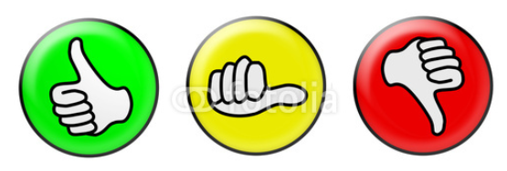
Grading
Time spent on project
Active participation in coaching/working blocks
Outcome at play-testing

Slide 11
Unity 3D game engine
Dominant game engine (45%)
Can do much without extensive programming
Many resources online – look them up!
Tutors will give case study talks

Slide 12
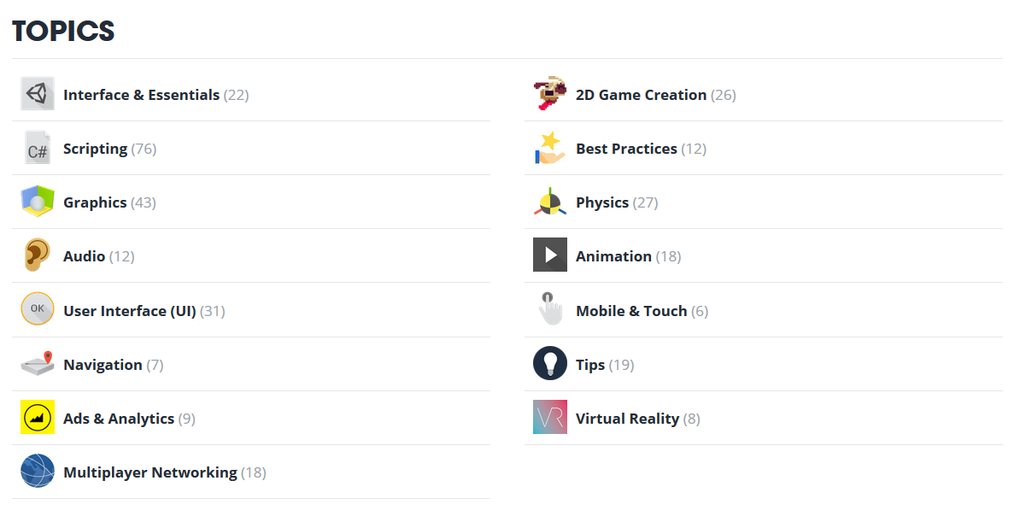
Unity 3D unity3d.com/learn/tutorials

Slide 13
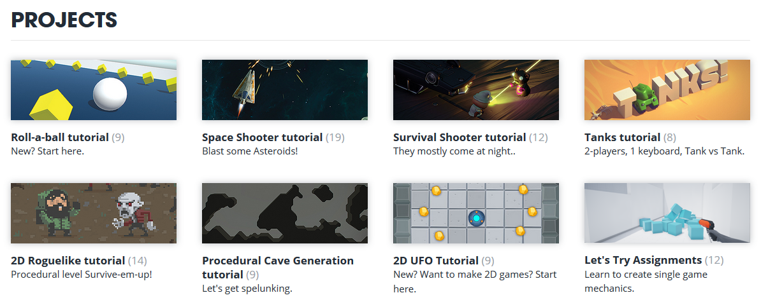
Unity 3D unity3d.com/learn/tutorials

Slide 14
Resources
Github (goo.gl/pFsdx2)
Slides
Tutorials
goo.gl/PUvaAG
Commented links on games and computer graphics
All Game Relevant Events (and more)
Google calendar goo.gl/SySLwF
Moodle
Deliverable/project upload
Forums for questions

